Slide 1
Windows Administration
Telerik Software Academy
academy.telerik.com
Server Roles and Features
Borislav Varadinov
System Administrator
bobi@itp.bg

Slide 2

Table of Contents
What is a Role?
What is a role services?
What is a Feature?
What is a Server Manager?
What is a Microsoft Management Console (MMC)?
What is PowerShell?

Slide 3
What is a Role?
A Server Role is a server program (or set of server programs) that perform a specific server function
Roles describe the primary function of a server
Usually a specific server is dedicated to perform a single role that is heavily used in the network
A server could perform multiple roles if each role is only lightly used

Slide 4
What is a role services?
Role services allow you to control which role functionality is installed and enabled
Some roles have few separate role services

Slide 5
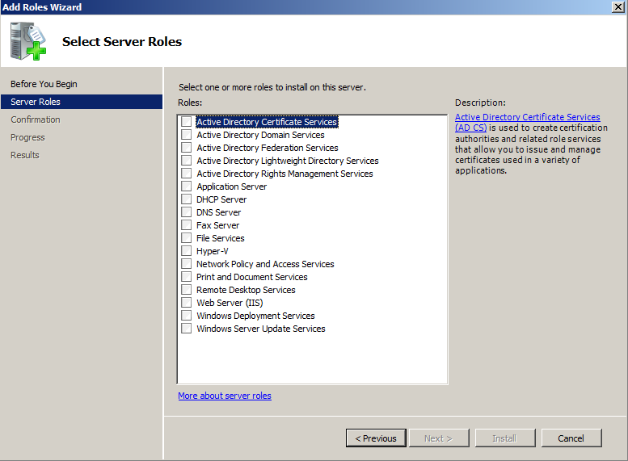
Overview of the roles

Slide 6
Multiple roles on a single server?
Security Considerations
Each role has specific security requirements
Attack surface
Support Considerations
Patching
Downtime
Delegation

Slide 7
What is a Feature?
Features are software programs that can support or increase the functionality of one or more roles
Usually features do not provide a service directly to clients
Features Example:
Windows Server Backup
Bitlocker Drive Encryption
Failover Clustering

Slide 8
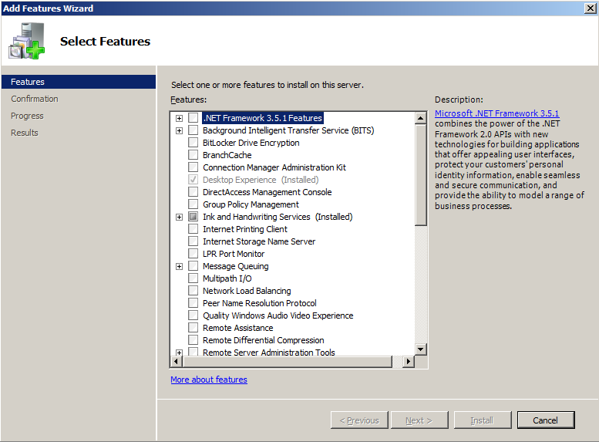
Overview of the features

Slide 9
What is a Server Manager?
Common administrative tool in Windows Server
Used to install and manage
Roles
Features

Slide 10
What is a Server Manager? (cont.)
Provides a single management source for:
Displaying and Analyzing roles status
Identifying problems with server role configuration
Managing Identity information
Managing roles' specific configuration
Managing system components
Managing devices and drivers
Managing Backups

Slide 11
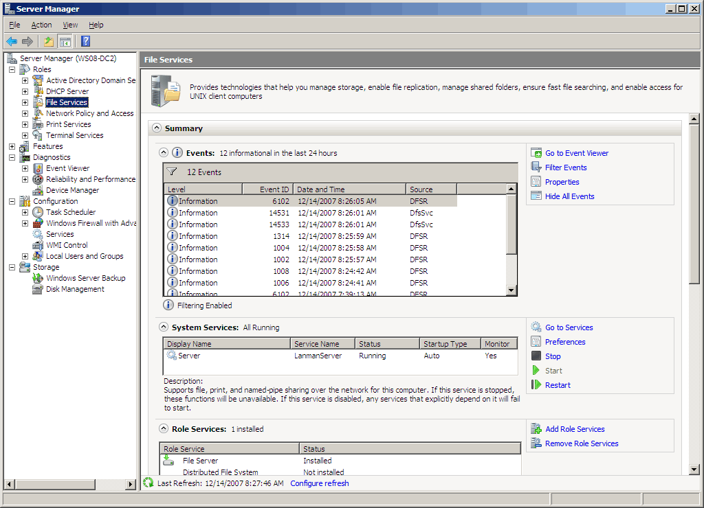
Server Manager
Server manager starts automatically when you logon to the server

Slide 12
Installing Roles and Features
Demonstration
Installing File Services
Installing Additional Role Services
Installing Windows Server Backup

Slide 13
What is a Microsoft Management Console (MMC)
MMC was introduced as optional package for Windows NT 4.0
MMC is a management component that provides an interface for configuring and monitoring the windows operating system and applications
MMC loads extensible components called snap-ins
Most of the administration tools are implemented as MMC snap-ins
Third parties can also develop and implement their own snap-ins to provide standardized management for their applications

Slide 14
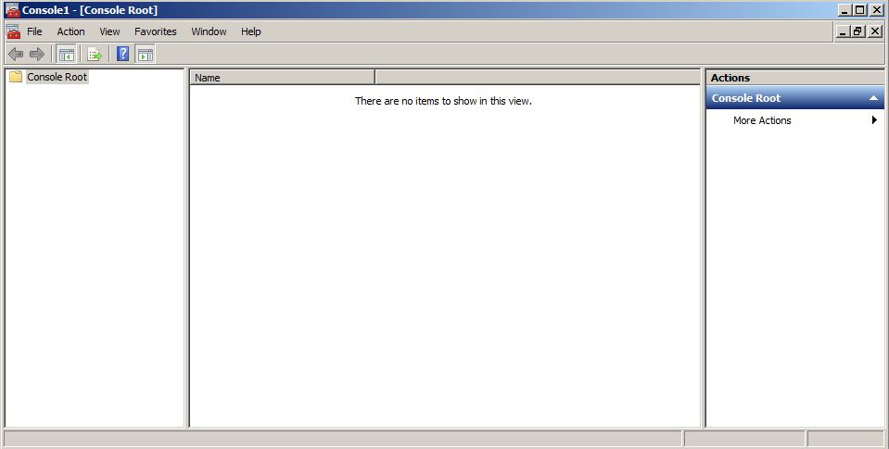
MMC

Slide 15
What is PowerShell
Next generation of interactive shell
Extremely PowerFul automation framework
Scripting environment
Extensible and Modular scripting platform
Foundation to build GUI management consoles
Easy to Learn

Slide 16
Server Roles and Features
http://academy.telerik.com

Slide 17




Free Trainings @ Telerik Academy
"Web Design with HTML 5, CSS 3 and JavaScript" course @ Telerik Academy
html5course.telerik.com
Telerik Software Academy
academy.telerik.com
Telerik Academy @ Facebook
facebook.com/TelerikAcademy
Telerik Software Academy Forums
forums.academy.telerik.com

